Slide 1

8086 Introduction
By
G HARISH BABU M.Tech, [ Ph.D ]
Asst Professor
Dept of ECE
CVR COLLEGE OF ENGINEERING

Slide 2
Register organization
8086 has a powerful set of registers containing general purpose and special purpose registers.
All the registers of 8086 are 16-bit registers
The general purpose registers, can be used either 8-bit registers or 16-bit registers.
The general purpose registers are either used for holding the data, variables and intermediate results temporarily or for other purpose like counter or for storing offset address for some particular addressing modes etc.
The special purpose registers are used as segment registers, pointers, index registers or as offset storage registers for particular addressing modes

Slide 3
AH | AL
BH | BL
CH | CL
DH | DL
SP
BP
SI
DI
IP
CS
SS
DS
ES
FLAG/PSW
GENERAL DATA REGISTERS
POINTER & INDEX REGISTERS
SEGMENT REGISTERS

Slide 4
ARCHITECTURE OF 8086

Slide 5
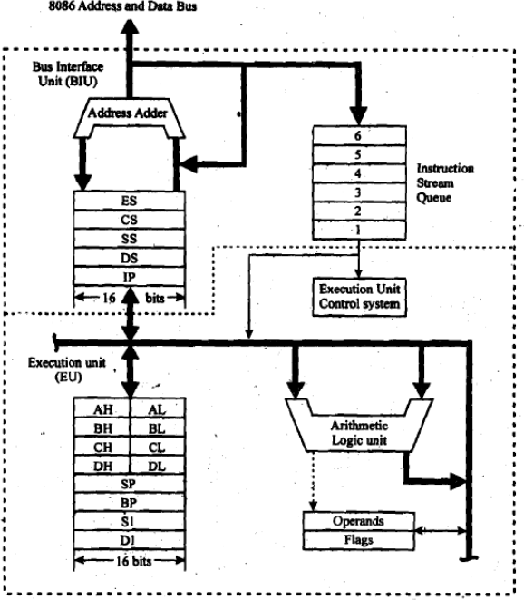

Slide 6
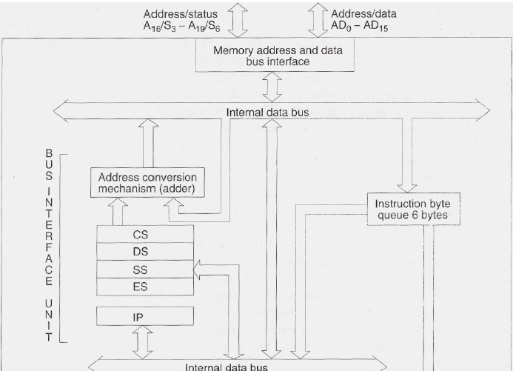
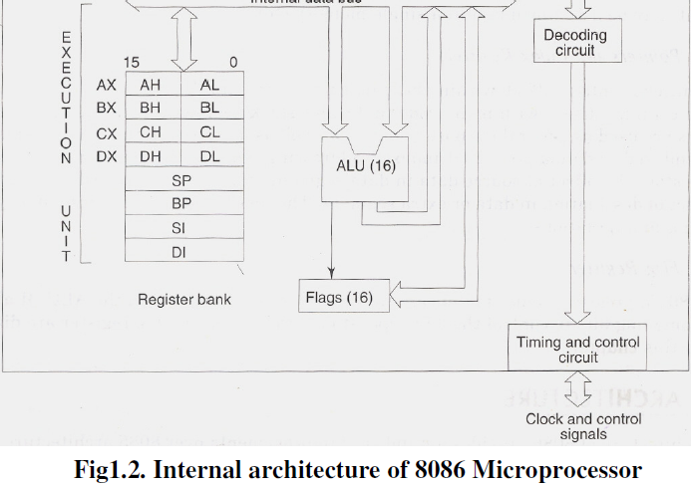

Slide 7
BIU (Bus interface unit)
Functions of Bus interface unit
It sends address of the memory or I/o.
It fetches instruction from memory.
It reads data from port/memory.
It writes data into port/memory.
It supports instruction queuing.
It provides the address relocation facility.

Slide 8

30007 h | 0 | 0 | 0 | 0 | 0 | 0 | 0 | 1
30006 h | 1 | 1 | 0 | 0 | 0 | 0 | 1 | 1
30005 h | 0 | 1 | 0 | 1 | 0 | 1 | 0 | 1
30004 h | 0 | 1 | 0 | 1 | 0 | 1 | 1 | 0
30003 h | 0 | 1 | 1 | 1 | 1 | 0 | 0 | 0
30002 h | 0 | 1 | 0 | 1 | 0 | 1 | 0 | 1
30001 h | 0 | 0 | 0 | 1 | 0 | 0 | 1 | 0
30000 h | 0 | 0 | 1 | 1 | 0 | 1 | 0 | 0
30000H
00110100
MEMORY
$$⅀$$
physical Address =segment address *10h + offset address
Ex:-CS=3000h , IP=0001h
PA=3000h*10h+0000h
=30000h+0000h
=30000h
6
5
4
3
2
1
ES
CS
SS
DS
IP
INCREMENT IP

Slide 9
30007 h | 0 | 0 | 0 | 0 | 0 | 0 | 0 | 1
30006 h | 1 | 1 | 0 | 0 | 0 | 0 | 1 | 1
30005 h | 0 | 1 | 0 | 1 | 0 | 1 | 0 | 1
30004 h | 0 | 1 | 0 | 1 | 0 | 1 | 1 | 0
30003 h | 0 | 1 | 1 | 1 | 1 | 0 | 0 | 0
30002 h | 0 | 1 | 0 | 1 | 0 | 1 | 0 | 1
30001 h | 0 | 0 | 0 | 1 | 0 | 0 | 1 | 0
30000 h | 0 | 0 | 1 | 1 | 0 | 1 | 0 | 0
00010010
30001H
MEMORY
$$⅀$$
physical Address =segment address *10h + offset address
Ex:-CS=3000h , IP=0001h
PA=3000h*10h+0001h
=30000h+0001h
=30001h
6
5
4
3
2
1
ES
CS
SS
DS
IP
INCREMENT IP

Slide 10
30007 h | 0 | 0 | 0 | 0 | 0 | 0 | 0 | 1
30006 h | 1 | 1 | 0 | 0 | 0 | 0 | 1 | 1
30005 h | 0 | 1 | 0 | 1 | 0 | 1 | 0 | 1
30004 h | 0 | 1 | 0 | 1 | 0 | 1 | 1 | 0
30003 h | 0 | 1 | 1 | 1 | 1 | 0 | 0 | 0
30002 h | 0 | 1 | 0 | 1 | 0 | 1 | 0 | 1
30001 h | 0 | 0 | 0 | 1 | 0 | 0 | 1 | 0
30000 h | 0 | 0 | 1 | 1 | 0 | 1 | 0 | 0
01010101
30002H
MEMORY
$$⅀$$
physical Address =segment address *10h + offset address
Ex:-CS=3000h , IP=0002h
PA=3000h*10h+0002h
=30000h+0002h
=30002h
6
5
4
3
2
1
ES
CS
SS
DS
IP
INCREMENT IP

Slide 11
30007 h | 0 | 0 | 0 | 0 | 0 | 0 | 0 | 1
30006 h | 1 | 1 | 0 | 0 | 0 | 0 | 1 | 1
30005 h | 0 | 1 | 0 | 1 | 0 | 1 | 0 | 1
30004 h | 0 | 1 | 0 | 1 | 0 | 1 | 1 | 0
30003 h | 0 | 1 | 1 | 1 | 1 | 0 | 0 | 0
30002 h | 0 | 1 | 0 | 1 | 0 | 1 | 0 | 1
30001 h | 0 | 0 | 0 | 1 | 0 | 0 | 1 | 0
30000 h | 0 | 0 | 1 | 1 | 0 | 1 | 0 | 0
00010010
30003H
MEMORY
$$⅀$$
physical Address =segment address *10h + offset address
Ex:-CS=3000h , IP=0003h
PA=3000h*10h+0003h
=30000h+0003h
=30003h
6
5
4
3
2
1
ES
CS
SS
DS
IP
INCREMENT IP

Slide 12
EU (Execution Unit)
Control circuitry.
Instruction Decoder.
ALU.
Flag register.
General purpose registers.
Pointer and index registers.

Slide 14
Flag register
The 8086 has 16 bit Flag register.
It is divided into two parts
Condition code or status flags.
Machine control flags.
(D,I,T)
15 | 14 | 13 | 12 | 11 | 10 | 9 | 8 | 7 | 6 | 5 | 4 | 3 | 2 | 1 | 0
X | X | X | X | O | D | I | T | S | Z | X | Ac | X | P | X | Cy

Slide 15
Memory Segmentation
The memory in an 8086/8088 based system is organised as segmented memory.
The complete physical memory (1MB) is divided into a 16 logical segments.
Each segment is 64Kb size.
The 16 bit contents of the segment register actually point to the starting location of a particular segment.
To address a specific memory location within a segment we need an offset address.
The offset address is also 16 bit long so that the maximum offset value can be FFFFh

Slide 16
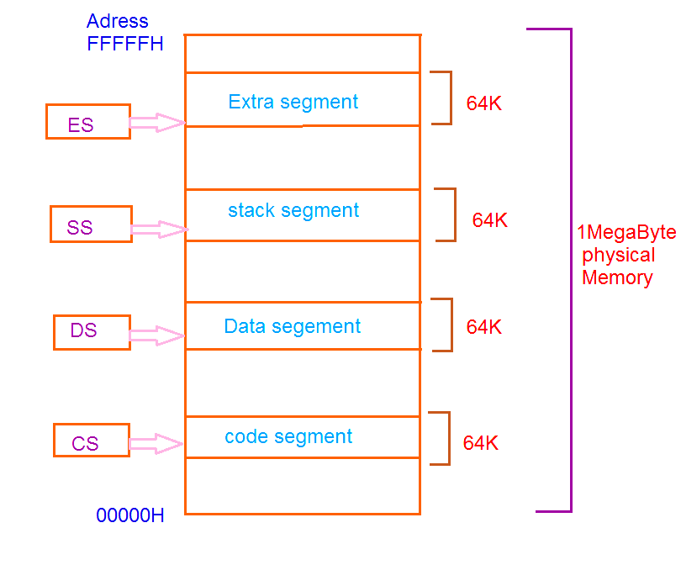

Slide 17
NON OVERLAPPING SEGMENTS
OVERLAPPING SEGMENTS
FFFFFH
FFFF 64KB 0000
FFFF 64KB 0000
FFFFFH
FFFF 64KB
FFFF 0000,1A01
1A00 64KB 0000
SEGMENT 2
SEGMENT
Offset IP2
2500H
CS2
Offset IP2
OVERLAP
CS2
Overlapped segmented area
SEGMENT 1
Offset IP1
Offset IP1
1000H
CS1
CS1
00000H
0000H

Slide 18
Advantages
Allows the memory capacity to 1MBytes although the actual address to be handled are 16 bit size.
Allows the placing of code , data and stack portions of the same program in different parts (segments) of memory , for data and code protection.
Permits a program and/or its data to be put into different areas of memory each time the program is executed i.e provision for relocation is done.

Slide 19
Memory segmentation
Rules for memory segmentation
1.The four segments can overlap for small programs. In a minimum system all four segments can start at the address 00000h.
2.The segment can begin/start at any memory address which is divisible by 16.

